Slide 1
Presented By: Joseph J. Burgarino, M.D.
Neurology | Neuropsychiatry
Post-Concussion Syndrome and Traumatic Brain Injury

Slide 2
Epidemiology
More than 2 million patients seen in the US emergency rooms annually
5% of all deaths are due to head injury
In the US, a head injury occurs every 7 seconds and a death due to head injury occurs every 5 minutes.

Slide 3
Epidemiology
200,000 killed or permanently disabled due to head injury annually
Peak age for head injuries is age 15-24
Men are 4 times more affected than women
In all US regions, most prominent cause is MVA
  In metro areas, personal violence is main cause

Slide 4
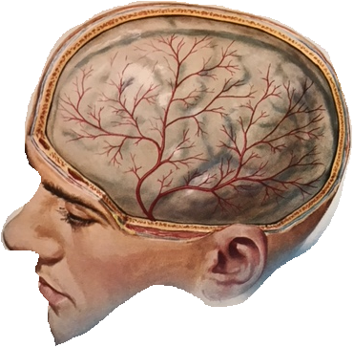
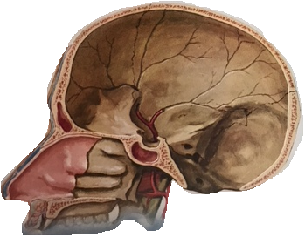

Slide 5
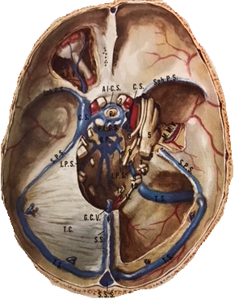
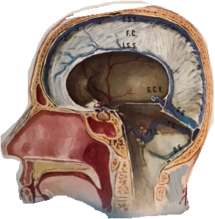

Slide 6
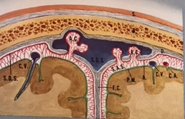
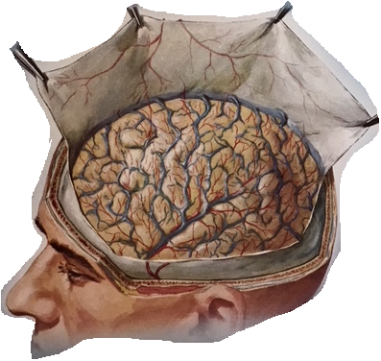

Slide 7
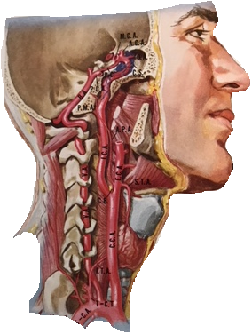
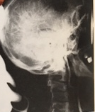
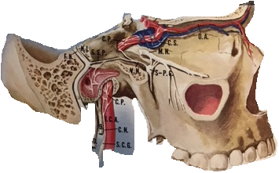

Slide 8
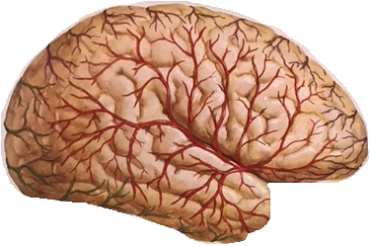
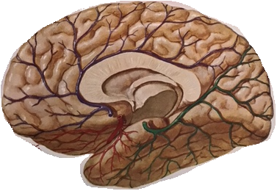

Slide 9
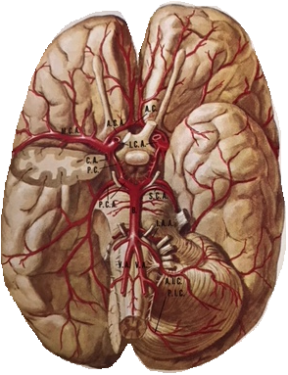
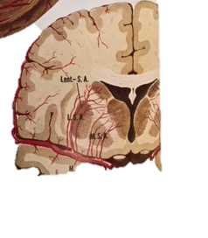

Slide 10
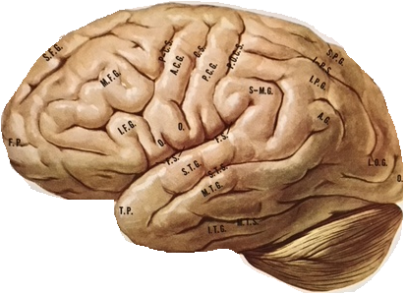
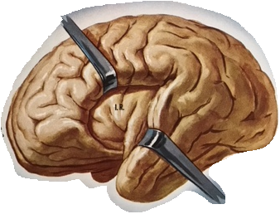

Slide 11
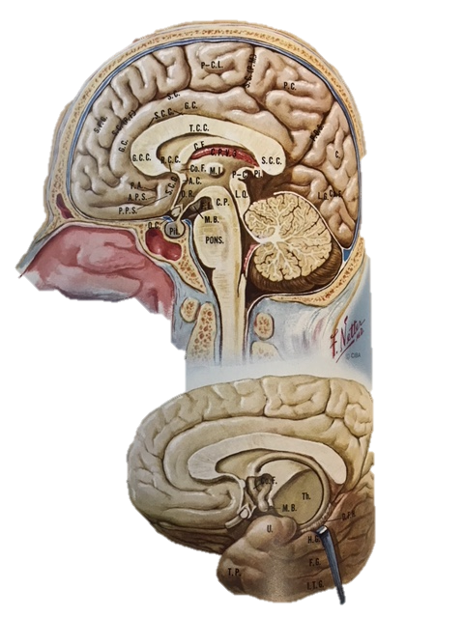

Slide 12
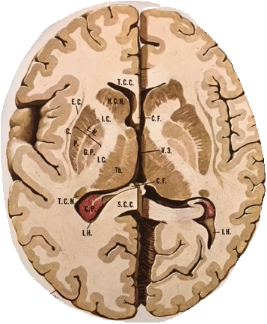
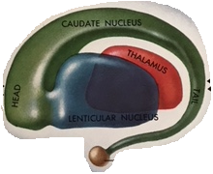

Slide 13
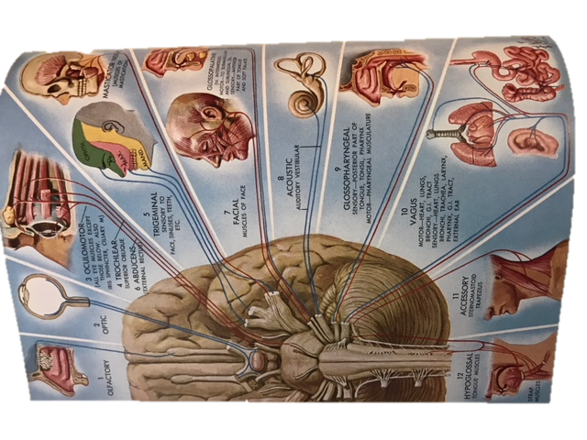

Slide 14
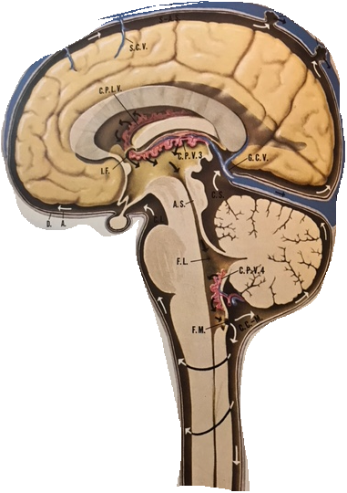

Slide 15
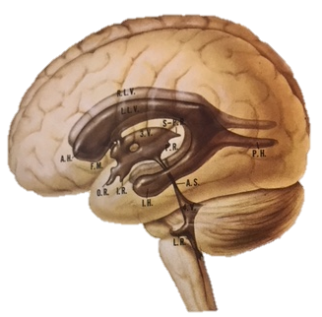
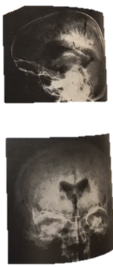
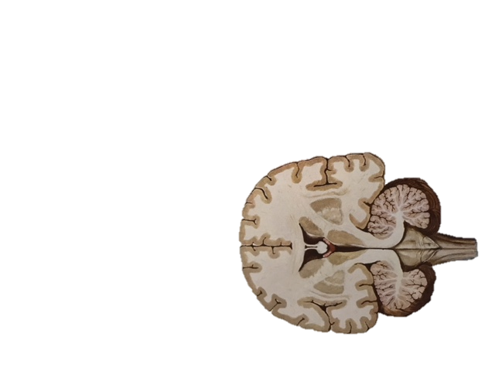

Slide 16
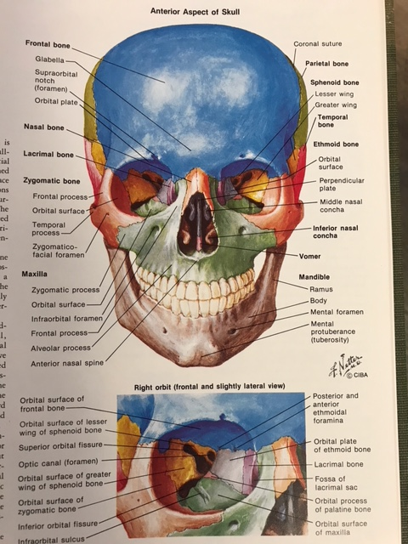

Slide 17
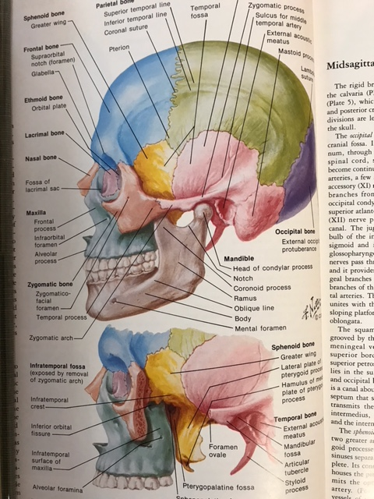

Slide 18
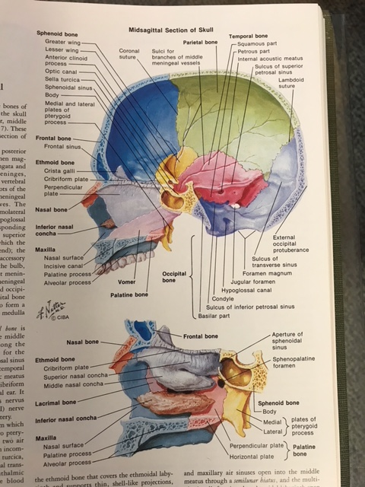

Slide 19
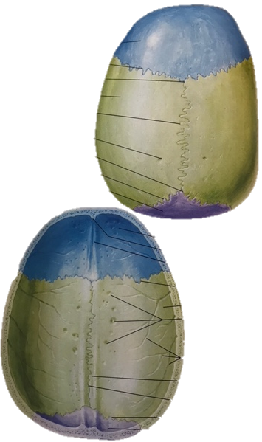

Slide 20
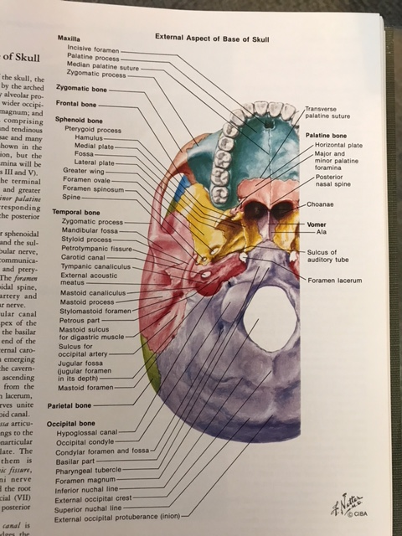

Slide 21
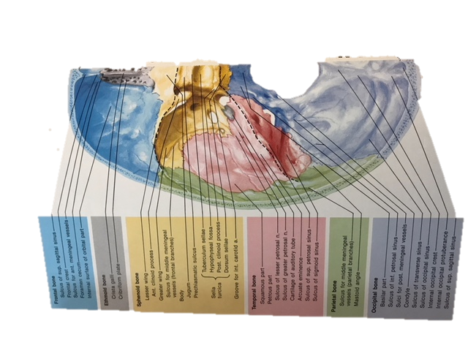

Slide 22
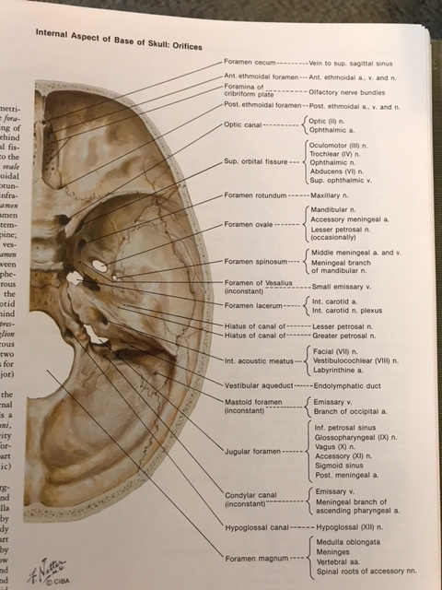

Slide 23
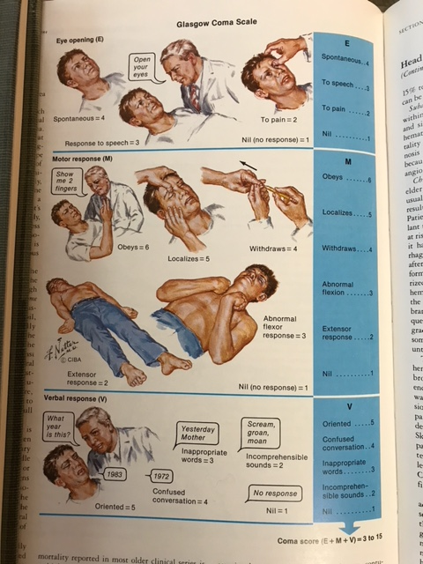

Slide 24
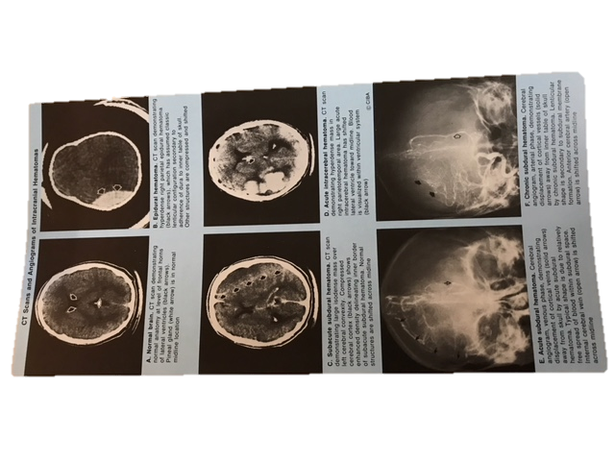

Slide 25
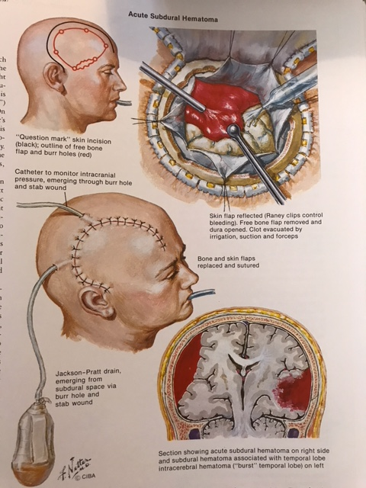

Slide 26
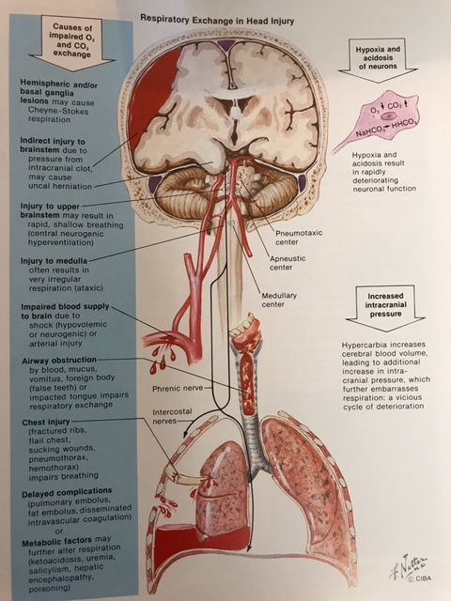

Slide 27
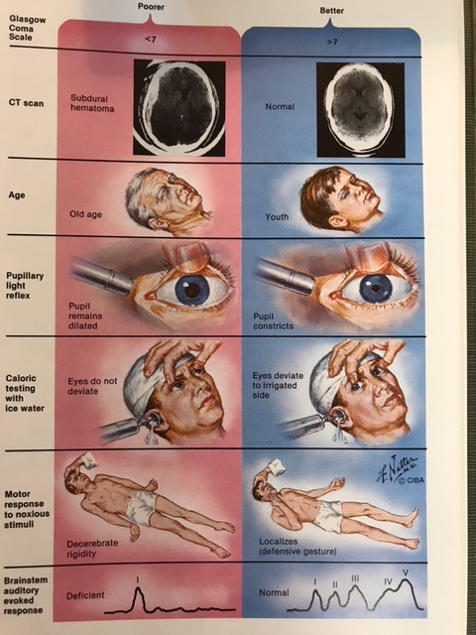

Slide 28
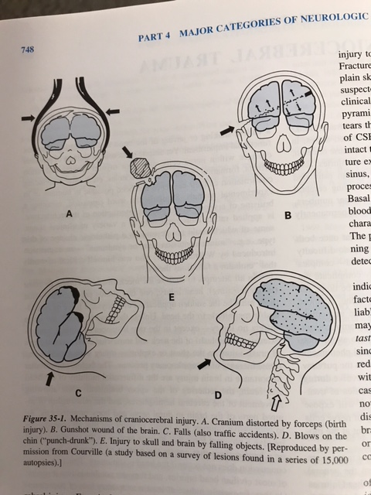

Slide 29
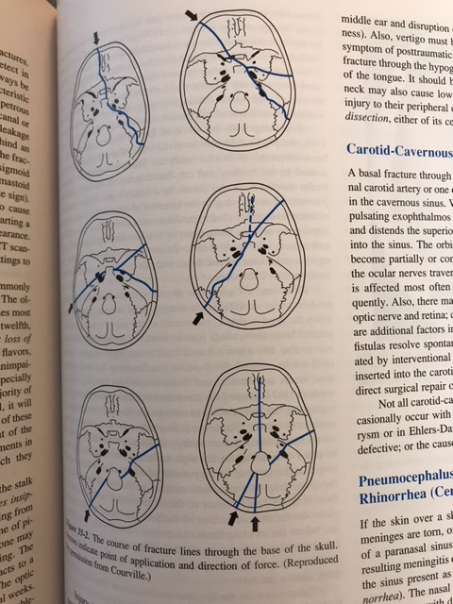

Slide 30
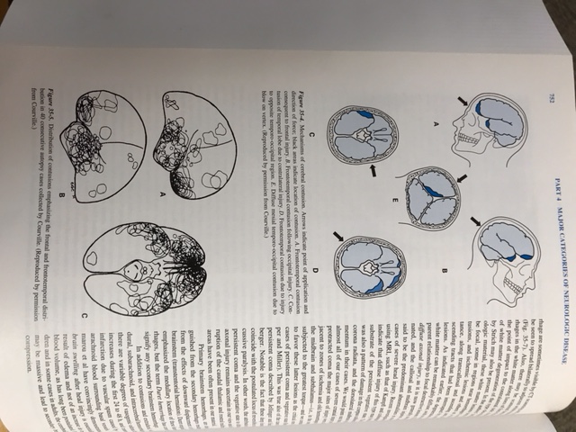

Slide 31
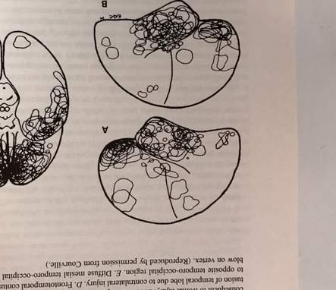

Slide 32
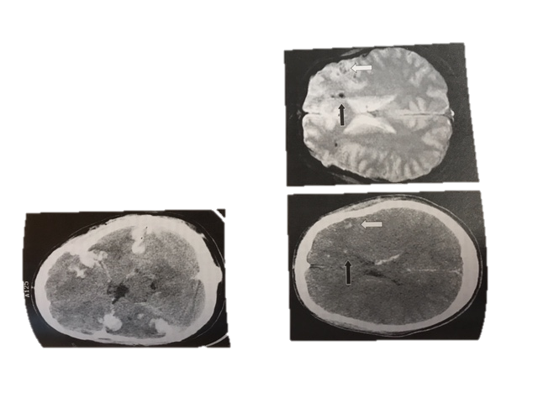

Slide 33
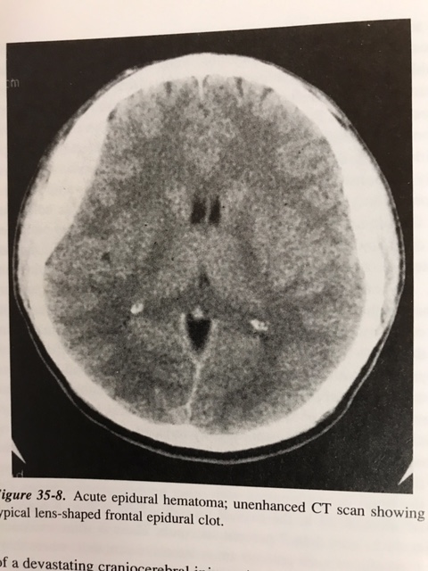

Slide 34
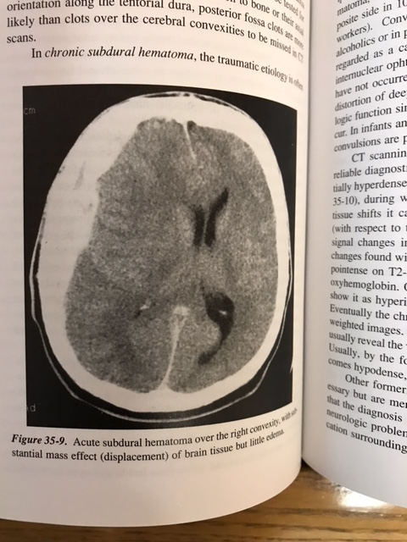

Slide 35
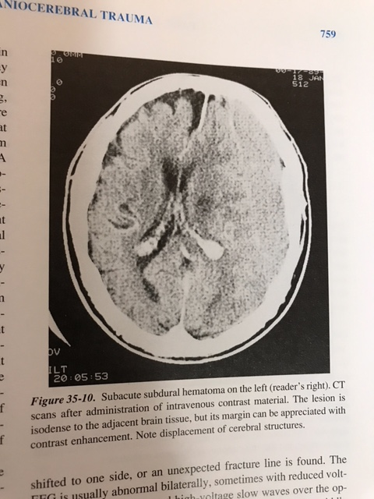

Slide 36
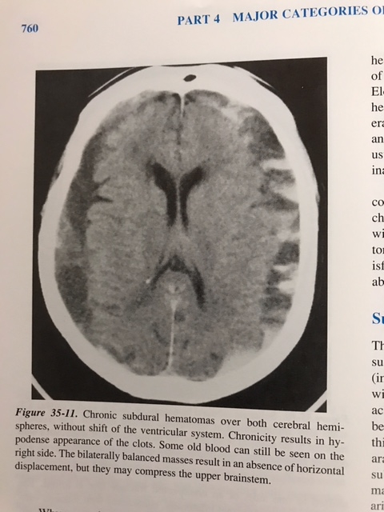

Slide 37
Pathophysiology of Craniocerebral Trauma
Skull Fractures
  Linear
  Depressed
  Comminuted
  Compound

Slide 38
Cerebral Concussion and Axonal Shearing

Slide 39
Cerebral Concussion and Axonal Shearing Injury

Slide 40
Brain Swelling, Cerebral Edema
Parenchymal Contusion and Hemorrhage

Slide 41
Parenchymal Contusion and Hemorrhage

Slide 42
Subdural Hematoma

Slide 43
Epidural Hematoma
Subarachnoid Hematoma

Slide 44
TBI, what to look for in the medical records

Slide 45
Potential blood tests for TBI

Slide 46
WAVI EEG

Slide 47
Diffusion tensor imaging MRI

Slide 48
Management
Risk Stratification of Patients with Head Injury

Slide 49
Glasgow Coma Scale

Slide 50
Criteria for Hospital
Admission After Head Injury
Intracranial blood or fracture identified on head CT
Confusion, agitation or depressed level of consciousness
Focal neurologic signs or symptoms
Posttraumatic seizure
Alcohol or drug intoxication
Significant comorbid medial illness
Lack of reliable home environment

Slide 51
Diagnosis
History
Examination
Imaging

Slide 52
Complications
Cerebrospinal fluid fistula
Pneumocephalus
Carotid-cavernous fistula
Vascular injury and thrombosis
Cranial nerve injury
Infections

Slide 53
Outcomes
Factors
  Depth of coma
  CT findings
  Age

Slide 54
Outcomes
Post-concussion syndrome
Seizures and posttraumatic epilepsy
Posttraumatic movement disorder

Slide 55
Estimated Mortality on Various Features

Slide 56
Estimated Mortality on Various Features

Slide 57


Q & A

Slide 58
Thank You

Slide 59


